Slide 1
SSN College of Engineering, Kalavakkam - 603110
Department of Information Technology
UG Project Work – Phase I – Review III
Bayesian Belief Network-Driven Proactive Fault Tolerance for Microservice Placement in Fog Computing Environments
Rahul Akshath Rajendran – 3122235002095
Mohit R – 3122235002072
Project Guide: Dr. Sabireen H, Assistant Professor
Notes:
Good morning. We are presenting the third review of our project on Bayesian Belief Network-driven proactive fault tolerance for microservice placement in fog computing. Since Review 2 the design has been implemented inside iFogSim2 and evaluated end to end; today we show the implementation, a live demonstration and the results.

Slide 2
Outline
1
Problem Statement
6
Implementation
2
Motivation and Research Gap
7
Demonstration
3
Proposed Work
8
Experiments and Results
4
Methodology
9
Inferences
5
Dataset Description
10
Conclusion and Future Work
New since Review 2: dataset, implementation, demonstration and results (items 5–8)
Notes:
A quick map of the talk: we restate the problem and the proposal briefly, spend most of the time on what is new since Review 2 — the dataset, the implementation, the demonstration and the results — and close with what the results do and do not show.

Slide 3
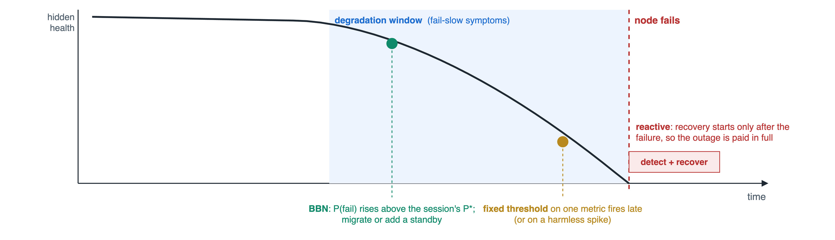
Problem Statement
Fog nodes are fragile and usually degrade before they fail, yet fog fault tolerance is reactive (recovery starts after the failure) or threshold-based (a fixed cut-off on one metric). No existing mechanism estimates the probability that a node fails within a given horizon, so placement, migration and redundancy cannot be matched to the actual risk — and a silent telemetry channel, likely on a failing node, simply blinds them.
A proactive mechanism must act inside the degradation window, before the node fails
Notes:
Fog nodes fail far more often than data-centre machines, and they usually degrade before they stop. Existing fog fault tolerance reacts after the failure, or uses a fixed threshold on one metric. Neither puts a probability on failure, so neither can weigh the risk against the cost of acting. The figure shows the opportunity: the degradation window before a failure.

Slide 4
Motivation and Research Gap
Work | Mechanism | What it lacks
Rajab & Younis 2021 | CPU-threshold checkpointing, primary-backup | fixed threshold; backup for every task
Syed et al. 2022 | SDN priority routing, ACK retransmission | purely reactive; no replication
Naim et al. 2016 | heartbeat polling, backup failover | detection-driven; single backup
Reyana et al. 2023 | PSO-ABC placement optimisation | reliability only a static fitness term
Gupta & Singh 2025 (FTAPA) | health-index threshold migration | threshold hard to set; standby for all
The gap
Node health is never treated as a latent, uncertain quantity
No mechanism reasons when telemetry is incomplete
No calibrated probability to weigh against the cost of acting
Redundancy is uniform, not proportional to risk
Why a Bayesian Belief Network: it needs no large failure corpus (tables start from expert priors), sums out missing channels instead of imputing them, outputs a probability that can be multiplied by a cost, and names the condition behind each alarm.
Notes:
From the survey: three of five systems are reactive, the two proactive ones rely on fixed thresholds, and all reserve redundancy uniformly. None models node health as a hidden condition with uncertainty, which is exactly what a Bayesian network provides.

Slide 5
Proposed Work
N1
BBN failure prediction
N2
Expected-loss migration and risk-aware placement
N3
Criticality-aware selective replication
P(node fails within 2 epochs | telemetry)
missing channels summed out, never imputed
names the condition behind the risk
learned by MAP-EM, refined online
migrate when P(fail) · C_fail > C_mig
every session gets its own threshold
placement utility over latency, energy and risk
weights follow patient criticality
tier = least overhead + expected loss
none · checkpoint · warm standby
warm standbys capped at 20% of sessions
recomputed every epoch
Since Review 2
Valid data
degradation fault model; leak fixed (92.1% → 2.0%)
Stronger BBN
trend channels, device class, supervised bins, ranked nodes
Built in iFogSim2
controller with N1–N3 and six comparison policies
Evaluated
unseen regimes and seeds; paired statistical tests
Notes:
Three novelties, one per objective, all now implemented. N1 predicts, N2 and N3 act on the prediction. Below them, the four things that changed between the Review 2 design and the system we evaluated.

Slide 6
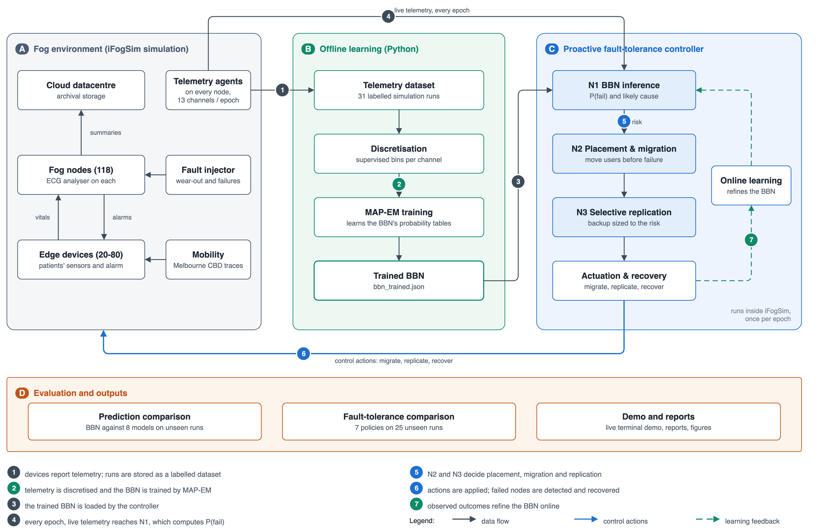
Methodology — System Block Diagram
Notes:
Four blocks. A is the simulated fog environment with telemetry agents and a fault injector. B learns the BBN offline from 31 runs. C is the controller inside the simulator with the three novelties. D evaluates everything on unseen runs. The numbered flows go from telemetry to dataset, to trained model, to live inference, to decisions, to actuation, and back as online learning.

Slide 7
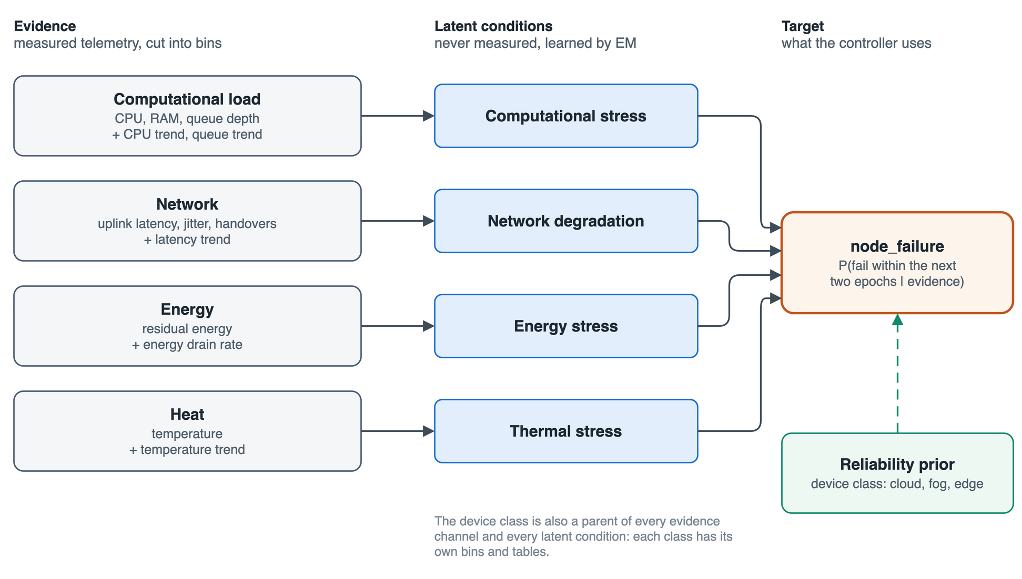
Methodology — The Bayesian Belief Network
Structure
13 evidence channels (8 from Review 2 + 5 trends) → 4 latent conditions → node_failure
Device class conditions every channel and condition
Learning
Supervised bins: ≤ 8 per channel and class, placed by exact DP on mutual information
Ranked-node tables: 40 numbers per class instead of 32,768 rows
MAP-EM: latent conditions never observed; 43,374 patterns, ≈ 10 s
Inference
Exact; a dark channel is summed out, never imputed
Cause = condition whose P(high) rose most above its prior
Notes:
Thirteen evidence channels feed four hidden conditions, which feed the failure target together with the device class. Because each channel feeds only one condition, inference is exact and takes about 3.6 microseconds. A missing channel is summed out. The tables are ranked nodes: one learned point per parent state instead of an exponential table, which is what made eight bins per channel learnable.

Slide 8
Methodology — Decision Rules
Placement (Eq. 4)
L̂: predicted loop latency / 150 ms deadline (with M/M/1 queueing)
Ê: access distance / 5 km (radio energy)
(α, β, γ) = (0.30, 0.10, 0.60) critical … (0.60, 0.25, 0.15) best-effort
U(m, n) = α(1 − L̂) + β(1 − Ê) + γ(1 − P(Fₙ = fail | e))
Migration (Eq. 5)
each session’s own threshold P* = C_mig / C_fail
unprotected: P* = 0.020 critical, 0.022 standard, 0.049 best-effort
no global threshold to tune
P(Fₙ = fail | e) · C_fail(m) > C_mig(m, n → n′)
Replication (Eqs. 6–7)
outage: none 330 ms · checkpoint ≈ 60–80 ms · warm 35 ms
critical patient: P = 0.001 → none; 0.05 → checkpoint; 0.30 → warm
warm standby for at most 20% of sessions
τ*(m) = argmin [ O(τ) + R(m) · D(τ) ]
R(m) = P(Fₙ = fail | e) · κ(m)
Notes:
Placement scores each node with a utility in which risk is one term and the weights depend on the patient. Migration compares expected loss with the cost of moving, so each session derives its own threshold: 0.020 for a critical patient, 0.049 for best-effort. Replication picks the tier with least overhead plus expected loss.

Slide 9
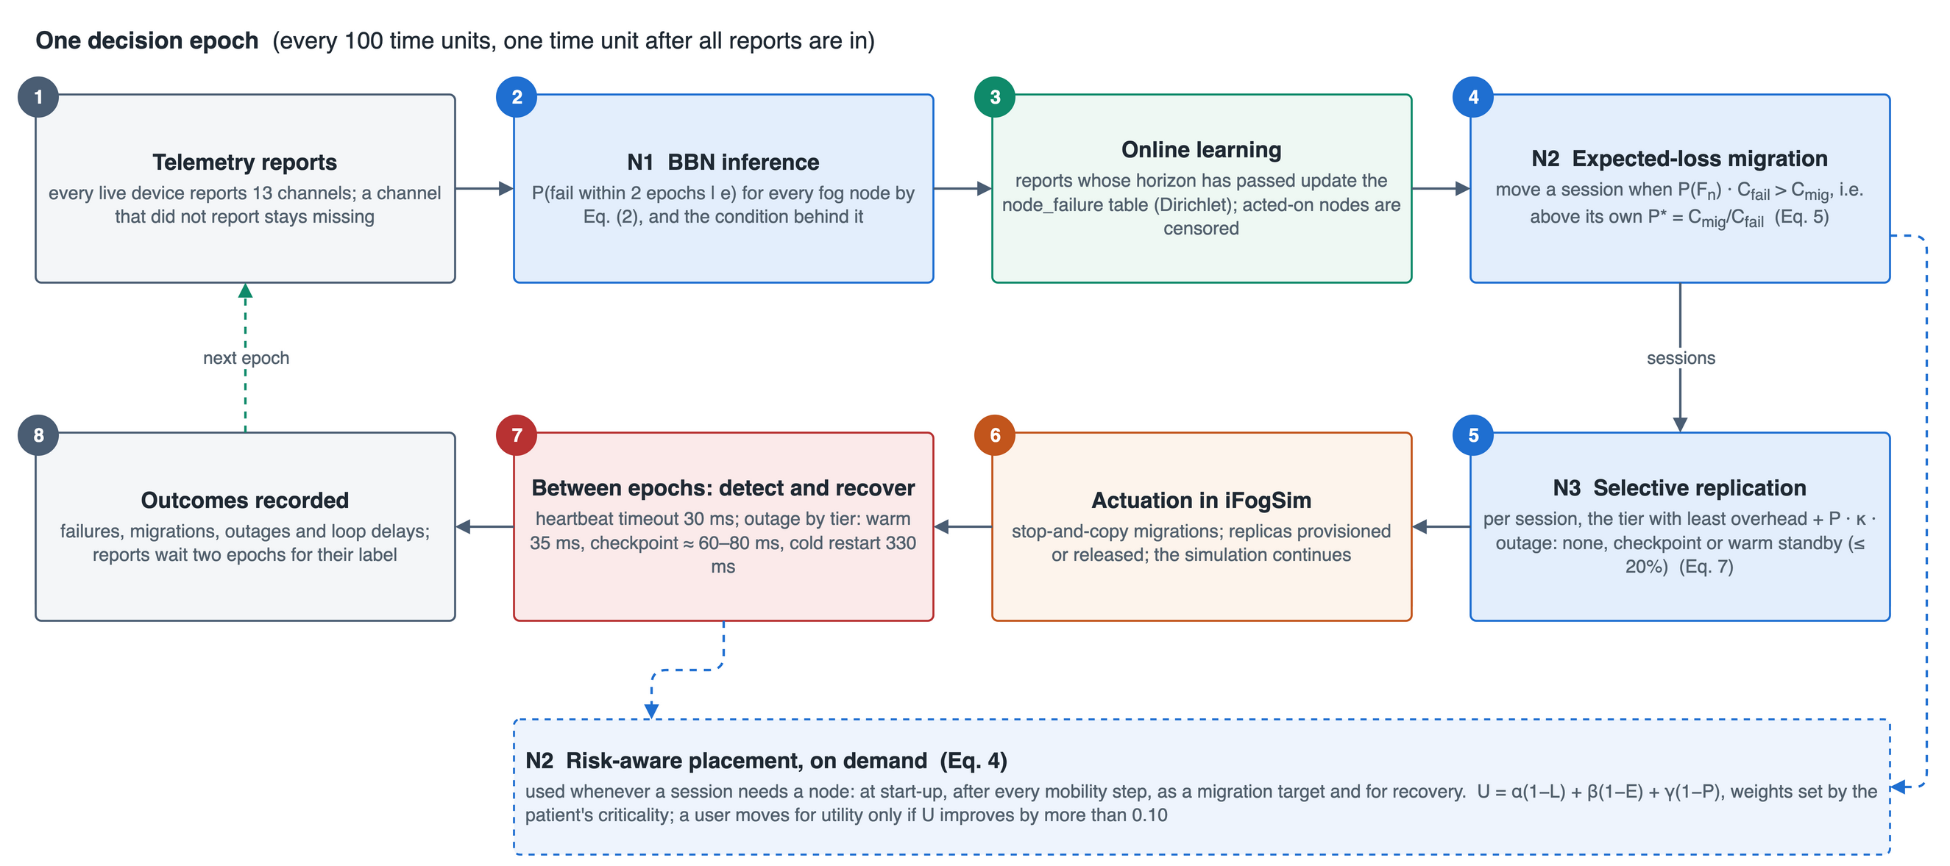
Methodology — Execution Flow per Epoch
Notes:
Every 100 time units the controller reads the reports, infers risk, learns from matured outcomes, migrates where the expected loss justifies it, re-tiers redundancy and lets the simulation run. Between epochs failures are detected after a 30 ms heartbeat timeout and recovered according to each session's tier. Placement is called whenever a session needs a node.

Slide 10
Dataset Description — Sources and Telemetry
Real inputs (shipped with iFogSim2)
Melbourne CBD edge resources: 1 cloud + 118 fog gateways at real coordinates
Mobility traces: 20–80 patients walk and hand over between gateways
Cardiac monitoring: vitals → ECG analyser on the fog node → alarm; deadline 150 ms
Patients: 25% critical, 45% standard, 30% best-effort
One record
One device at one epoch (100 time units); 13 channels + device class
Label: does the node fail within the next 200 time units?
Hidden health and failure cause stored, never used as features
Channel | Feeds | From iFogSim2
cpu_util, ram_util, queue_depth | computational | host work, RAM, queues
cpu_trend, queue_trend | computational | agent’s last 3 readings
uplink_latency, jitter_pktloss | network | link delay + load; arrivals
handover_rate, latency_trend | network | mobility; trend
residual_energy, energy_drain | energy | power model
temperature, temp_trend | thermal | fog/cloud only
Missing values stay missing: temperature on edge devices, jitter with fewer than three tuples, trends without history.
Notes:
There is no public failure trace for fog, so the dataset is generated by our instrumented iFogSim2 from real inputs shipped with the simulator: the Melbourne CBD topology and mobility traces, and a cardiac-monitoring application. Every device reports thirteen channels every epoch; an empty value means the channel did not report.

Slide 11
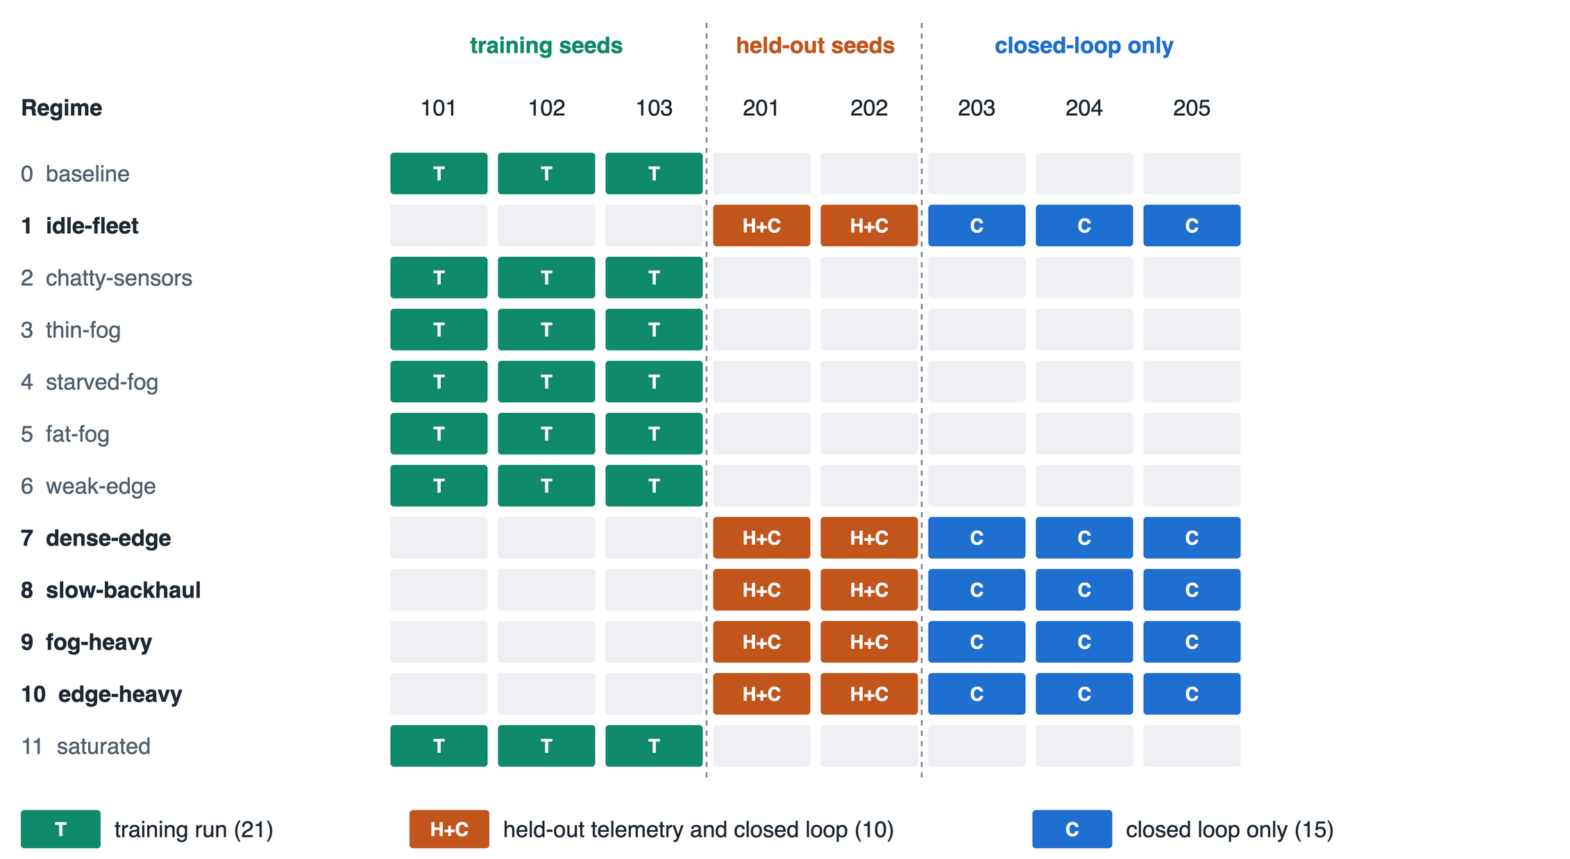
Dataset Description — Fault Model and Split
Fault model
Hidden health wears faster under load, backlog, heat, energy depletion and poor links
Fail-slow symptoms inside iFogSim: more CPU per tuple, slower links, more power and heat
Wear-out, battery and sudden failures (≈ 1 in 5, no precursor)
Pool | Runs | Snapshots | Failing | Prevalence
Training | 21 | 314,323 | 1,508 | 0.48%
Held out | 10 | 160,823 | 422 | 0.26%
12 operating regimes; held-out runs use unseen regimes and unseen seeds
Leak audit: shared failures at the same epoch 92.1% (Review 2 injector) → 2.0% now, i.e. chance level
Notes:
iFogSim has no failures, so we added a degradation model: hidden health wears faster under stress and shows fail-slow symptoms that the telemetry can see. One failure in five is sudden. Whole regimes and seeds are held out, and the leak audit confirms independence: 2 percent of shared failures coincide, which is chance.

Slide 12
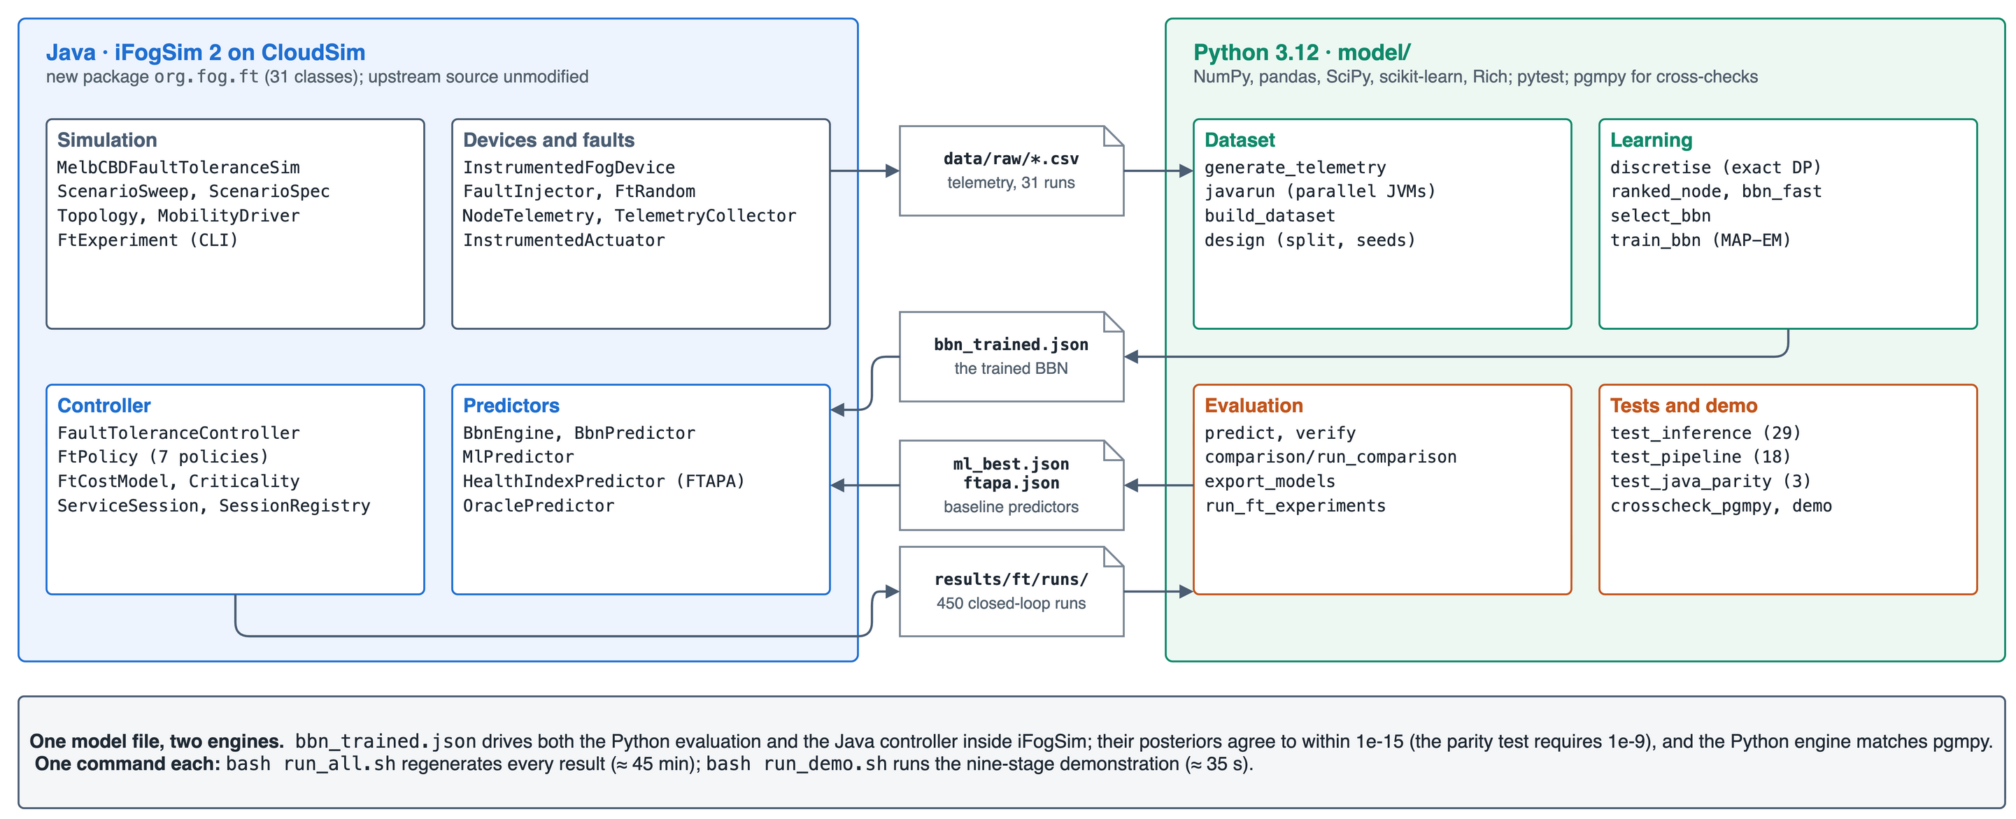
Implementation — Technology Stack and Code
Notes:
The Java side is one new package of 31 classes inside an unmodified iFogSim2; the Python side builds the data, trains and evaluates. They share one model file, and the Java and Python engines agree to 1e-15. Fifty tests and a pgmpy cross-check guard correctness, and two scripts regenerate everything or run the demo.

Slide 13
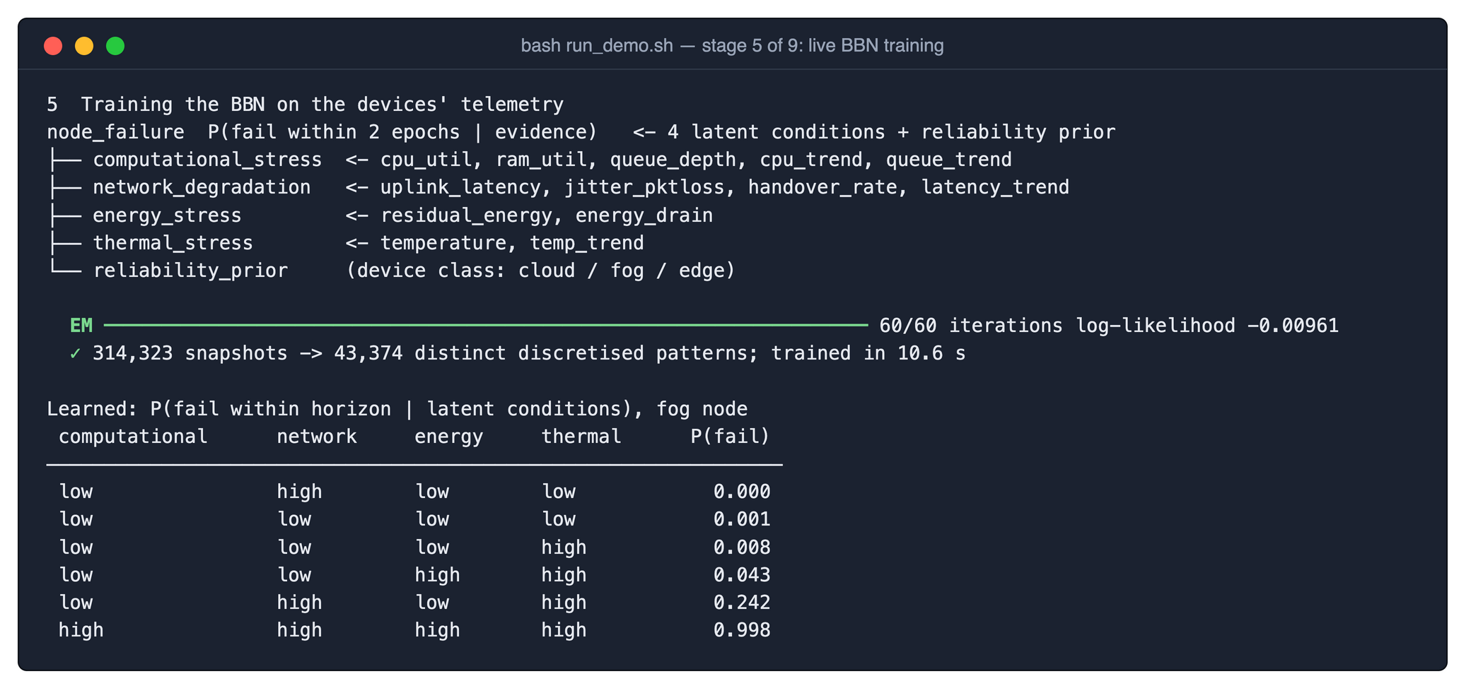
Demonstration — bash run_demo.sh (1/3)
Nine stages, ≈ 35 s
1
Build the iFogSim extension
2
The simulated system
3
Telemetry from the devices
4
Dataset and leak audit
5
Live BBN training
6
Prediction comparison
314,323 → 43,374
10.6 s
identical
7
Live BBN inside iFogSim
snapshots merged into distinct patterns
60 MAP-EM iterations, live
retrained model = the one behind every result
8
All policies, same run
9
Verdict
Notes:
The demo runs in about 35 seconds and has nine stages. Here is stage five: the BBN is retrained live from the devices' telemetry, from 314 thousand snapshots compressed to 43 thousand patterns, in about ten seconds, and the learned failure table is printed. The retrained model is identical to the one behind every reported result.

Slide 14
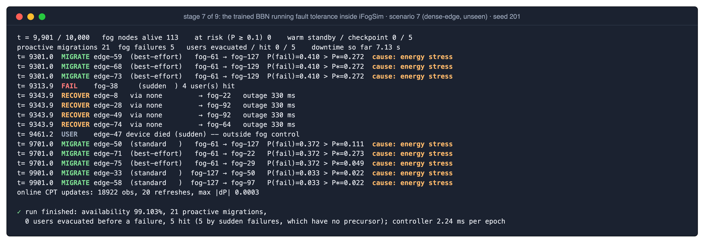
Demonstration — BBN Controlling iFogSim Live (2/3)
Proactive migration
sessions leave fog-61 at P(fail) = 0.41 > P* = 0.272 — cause: energy stress
Own thresholds
same node, different P*: 0.111 standard vs 0.273 best-effort
Sudden failure
fog-38 has no precursor; 4 users recovered by cold restart (330 ms)
Notes:
Scenario 7 with seed 201, both unseen in training. fog-61 is wearing out: the BBN puts its failure probability at 0.41 and blames energy stress, and each session moves when that exceeds its own threshold. fog-38 fails suddenly, which no predictor can see; its four users are detected and recovered by cold restart. The controller needs 2.24 ms per epoch.

Slide 15
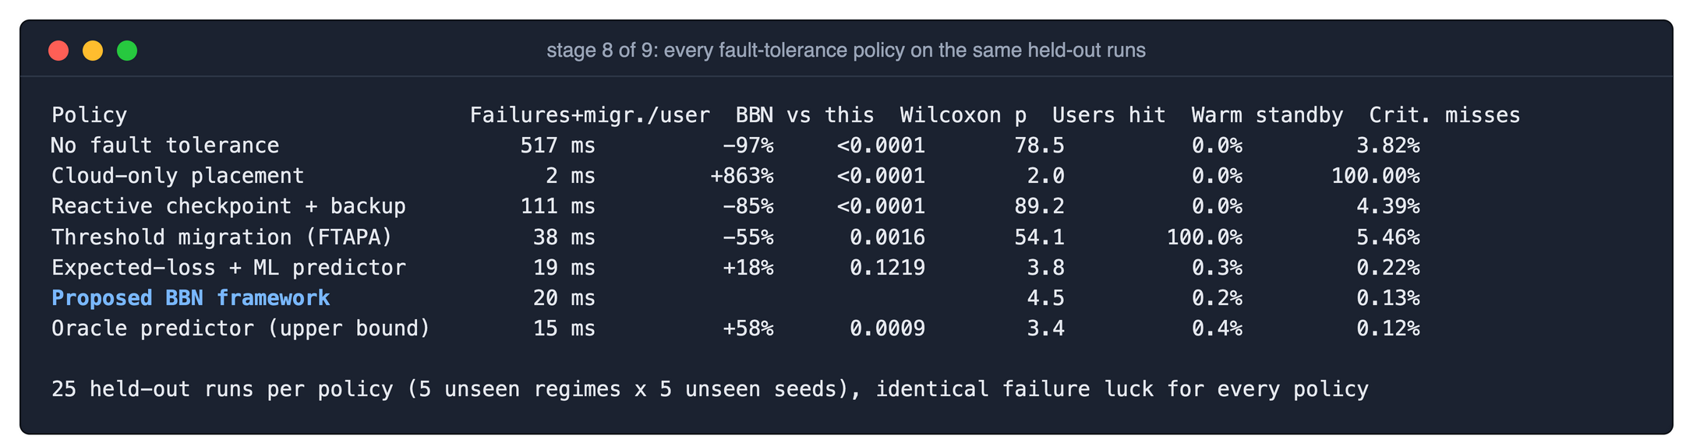
Demonstration — Every Policy on the Same Runs (3/3)
−97%
−55%
0.2%
+18%
vs no fault tolerance
vs FTAPA threshold migration
warm standby (FTAPA: 100%)
vs ML controller, p = 0.12 (n.s.)
Notes:
Stage eight runs all seven policies with identical failure luck and then shows the summary over all 25 held-out runs with paired Wilcoxon tests. Against FTAPA the BBN framework cuts fault downtime by 55 percent with a standby for 0.2 percent of sessions instead of all of them. Against the ML-driven controller the difference is not significant with complete telemetry.

Slide 16
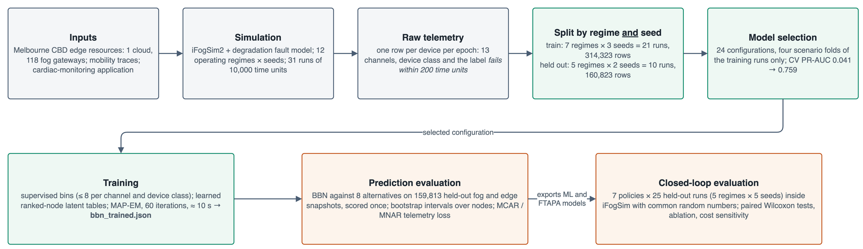
Experiments — Protocol and Performance Metrics
Protocol
choices on 4 scenario folds of training runs
held-out pool scored once
bootstrap CIs over nodes
paired Wilcoxon tests, 25 runs
Prediction metrics
ROC-AUC, PR-AUC (chance 0.0026)
Brier, log-loss, ECE (calibration)
precision, recall, F1; early warning
robustness to MCAR / MNAR loss
Service metrics
downtime per user: failures + migrations
users hit / evacuated; availability
critical deadline misses (150 ms), p95
warm-standby overhead
Baselines
predictors: RF, GB, NB, LR, MLP, FTAPA, CPU
policies: none, cloud-only, reactive
FTAPA threshold migration
ML-driven controller; oracle bound
Notes:
Every modelling choice is made on folds of the training runs; the held-out pool is scored once. Prediction is judged by ranking and by probability quality, because the controller multiplies the probability by a cost. The closed loop is judged by downtime split into the part fault tolerance controls and the part it cannot.

Slide 17
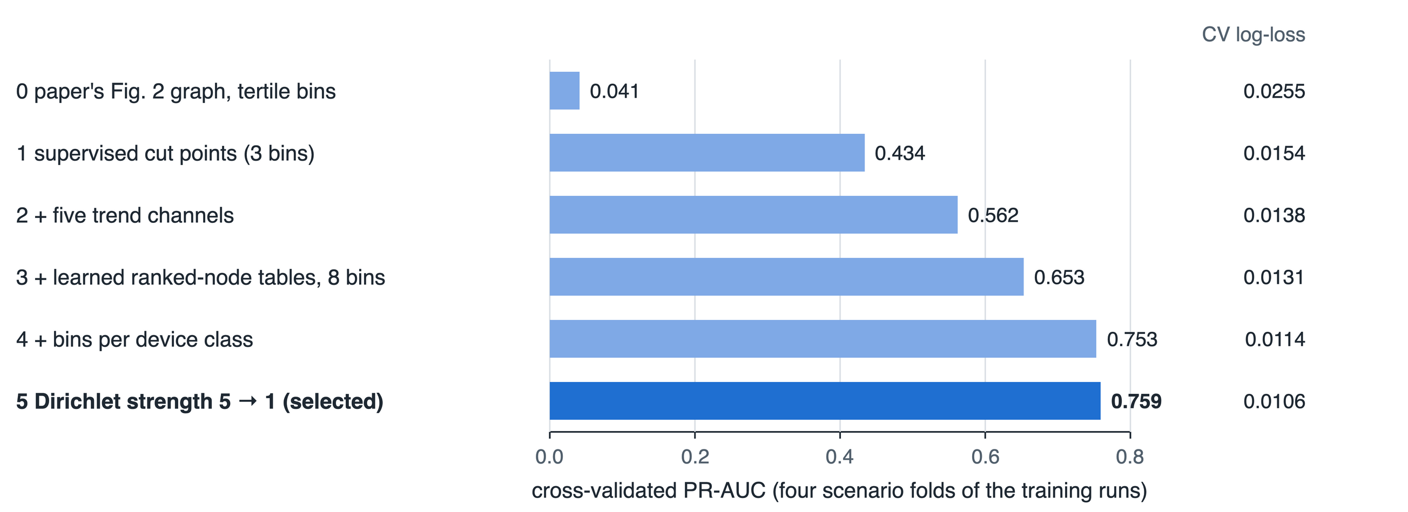
Results — Improving the BBN (Training Folds Only)
What moved accuracy
Tertiles hide the tail where failures live: 0.041
Supervised cut points: 0.434
Trend channels catch drift: 0.562
Ranked nodes make 8 bins learnable: 0.653
Per-class bins: 0.753 → 0.759
24 configurations, 4 scenario folds; the held-out pool was scored once, afterwards.
Then, once, on the held-out pool: ROC-AUC 0.866 · PR-AUC 0.639 · Brier 0.00128 · ECE 0.0005 — not directly comparable with the CV score: the training runs fail more often (0.48% vs 0.26%), and PR-AUC rises with prevalence
Notes:
The Review 2 graph with tertile bins was almost blind: cross-validated PR-AUC 0.041. Supervised bins were the biggest single gain, then trends, ranked nodes with eight bins, and per-class bins. All of this was decided on training scenarios; the held-out runs were untouched until the end.

Slide 18
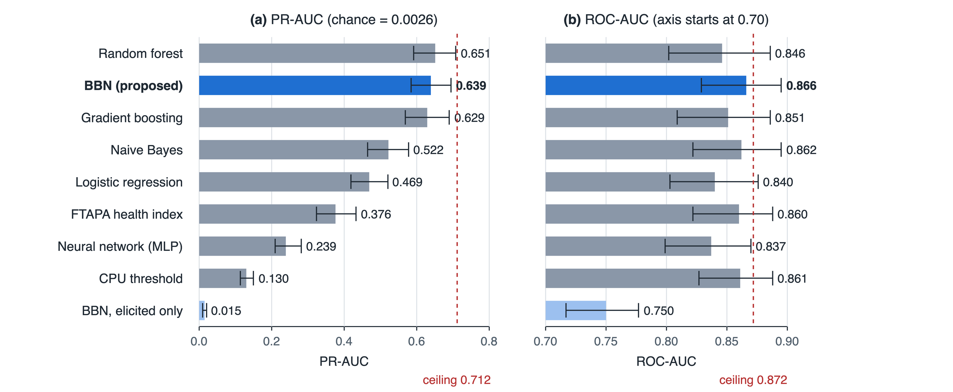
Results — Failure Prediction against Eight Models
0.866
ROC-AUC — best of 9 models
0.639
PR-AUC — tied with RF (0.651)
99% / 90%
of the achievable ROC / PR-AUC
63%
failing nodes flagged in time (RF 68%)
159,813 held-out snapshots, 422 failing (prevalence 0.26%); 95% bootstrap intervals over nodes
Notes:
On 160 thousand held-out snapshots the BBN has the best ROC-AUC and a PR-AUC tied with the random forest. Because 29 percent of failures are sudden, no model can exceed 0.872 and 0.712; the BBN reaches 99 and 90 percent of that. The random forest is slightly ahead on F1 and early detection, and we say so.

Slide 19
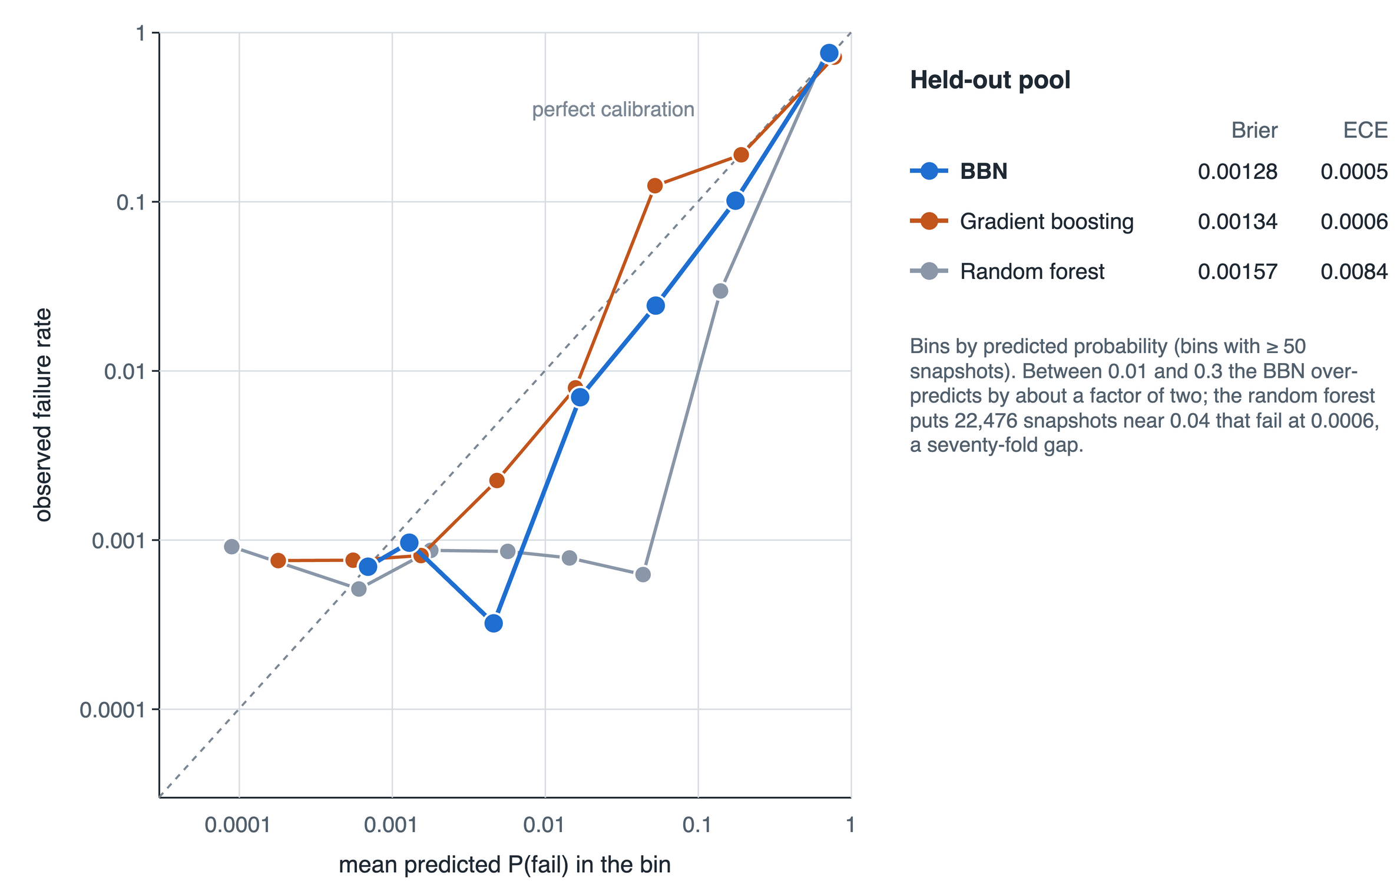
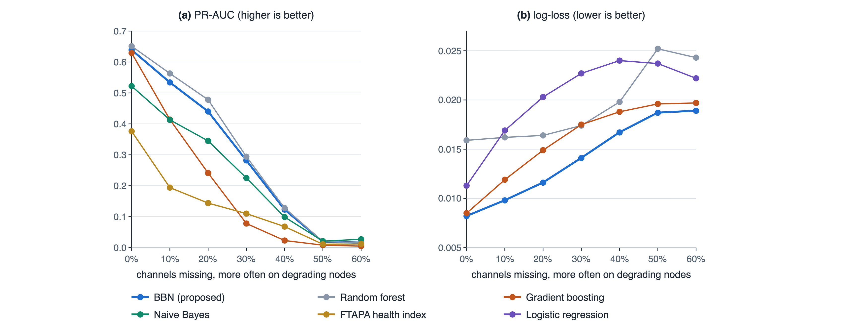
Results — Calibration and Missing Telemetry
Best Brier 0.00128 and ECE 0.0005: probabilities mean what they say — they are multiplied by costs
Lowest log-loss at every loss rate; under heavy loss Naive Bayes ranks best (ROC 0.821 vs 0.700)
Notes:
Left: the random forest ranks well but is badly calibrated, with 22 thousand snapshots at 0.04 that fail at 0.0006; the BBN is within about a factor of two. Right: when channels go missing more often on degrading nodes, the BBN keeps the best probabilities at every loss rate. Naive Bayes ranks best under heavy loss.

Slide 20
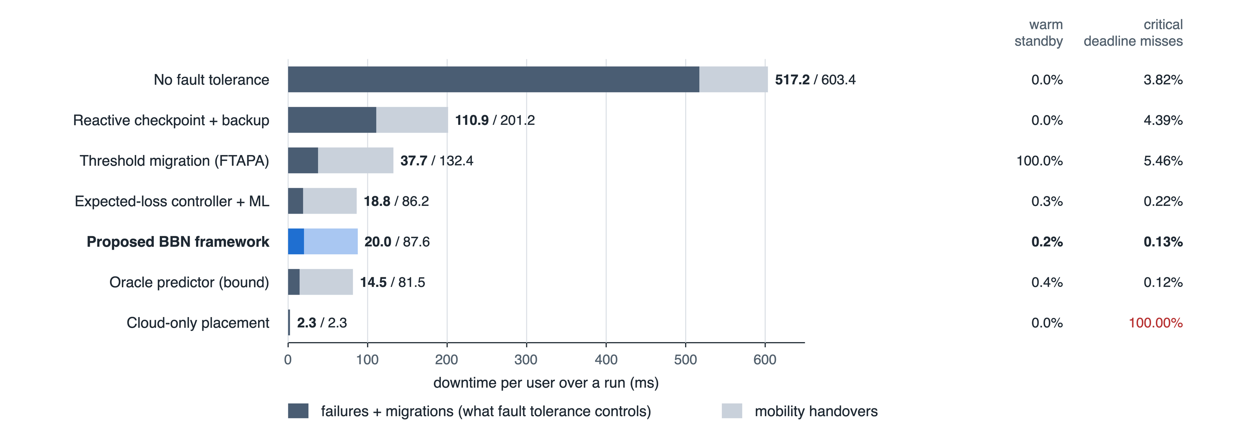
Results — Closed-Loop Fault Tolerance in iFogSim
−97 / −85 / −55%
fault downtime vs none, reactive, FTAPA
4.5
users hit per run (FTAPA 54.1)
0.13%
critical alarms past 150 ms
98.9%
of the oracle’s downtime reduction
Cloud-only placement: least downtime, but its 310 ms p95 loop delay misses every critical deadline
Notes:
Seven policies on the same 25 held-out runs. The dark part of each bar is what fault tolerance controls. The BBN framework cuts it by 97, 85 and 55 percent against no fault tolerance, reactive checkpointing and FTAPA, and misses the 150 ms deadline on 0.13 percent of critical alarms. Cloud-only looks good on downtime but misses every deadline.

Slide 21
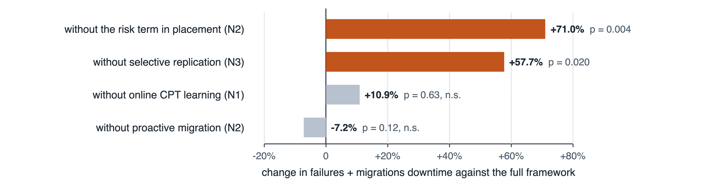
Results — Degraded Telemetry and Ablation
30% of channels missing on degrading nodes
Ablation: remove one component
Policy | Fault downtime / user | Total downtime / user
FTAPA threshold | 33.9 ms | 133.7 ms
Controller + ML | 90.6 ms | 156.2 ms
BBN framework | 65.9 ms | 131.8 ms
BBN vs ML controller: −29.2% fault downtime (p = 0.006)
Summing out a dark channel beats imputing a healthy-looking median
FTAPA is most robust on fault downtime (p = 0.004) — bought with a standby for every session
Risk-aware placement (+71%) and selective replication (+58%) are significant
Online learning and migration alone: not significant once placement and replication are risk-aware
Notes:
With 30 percent of channels missing on degrading nodes, the BBN-driven controller beats the ML-driven one by 29 percent: imputing a healthy median misleads, summing out does not. FTAPA, with a standby for everyone, is the most robust here. The ablation shows that risk-aware placement and selective replication carry the gain; migration alone is not significant.

Slide 22
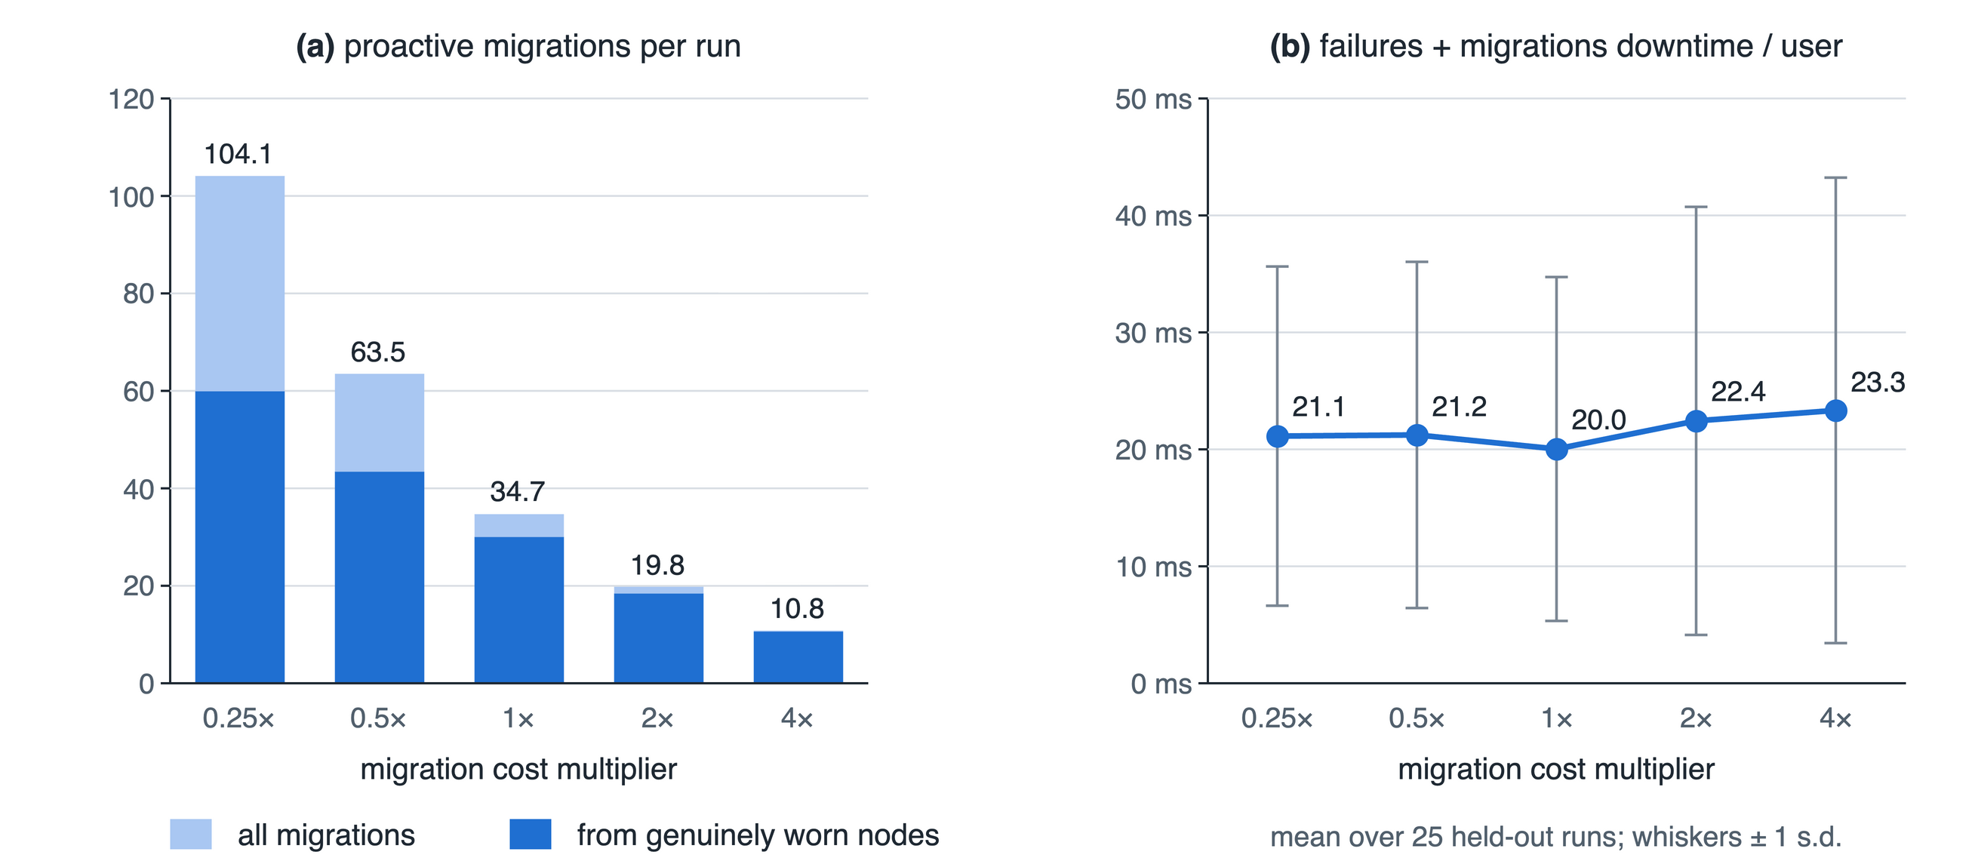
Results — Cost Sensitivity and Explanations
Does the named cause match?
Actual cause | Energy | Network | None
Battery (22) | 0.86 | 0.14 | 0.00
Wear-out (278) | 0.92 | 0.04 | 0.00
Sudden (122) | 0.16 | 0.30 | 0.52
Energy drain is the earliest wear symptom in this simulator
Sudden failures have no precursor: mostly no condition raised
Elicited tables alone (no failure data): ROC-AUC 0.750
Migrations fall 104 → 11 per run as the cost rises 16-fold
Fault downtime stays 20.0–23.3 ms per user: the rule calibrates itself
Notes:
Multiplying every migration cost by 0.25 to 4 changes the number of migrations tenfold but downtime stays at 20 to 23 ms per user: no threshold needs tuning. The named causes match how nodes failed: battery and wear-out failures are blamed on energy stress, and for half of the sudden failures nothing is raised, as it should be.

Slide 23
Inferences — Why a BBN, and Where It Is Not Ahead
Supported by the results
Ranks failures as well as the best of 8 models (ROC-AUC best; PR-AUC tied)
Best-calibrated probabilities — what cost-based rules need
Summing out missing telemetry: −29% fault downtime vs ML under MNAR loss
Beats thresholds with 0.2% standby instead of 100%
Usable before any failure is seen (elicited ROC-AUC 0.750)
Explains every alarm with a named condition
Where it is not ahead
Random forest: slightly higher PR-AUC (0.651), F1 (0.687), early detection (68%)
Complete telemetry: ML-driven controller equal (+18%, p = 0.12)
Heavy telemetry loss: every model collapses; Naive Bayes ranks best
Sudden failures (29%) cannot be predicted — only redundancy helps
Simulation study: a synthetic fault model, accelerated wear
Notes:
The honest summary. The BBN matches the best black box at ranking and is clearly the best at calibration, which is what decisions need. Its real advantage shows when telemetry fails with the node. It is not ahead everywhere: the random forest has slightly higher PR-AUC and F1, and nothing predicts sudden failures.

Slide 24
Conclusion and Future Work
Conclusion
A causal BBN, extended and learned by MAP-EM, predicts fog-node failure from incomplete telemetry and explains each alarm
Inside iFogSim2 it drives placement, expected-loss migration and selective replication
On unseen regimes and seeds: ROC-AUC 0.866 with the best calibration; fault downtime −97% / −85% / −55% vs none / reactive / FTAPA, with 0.2% warm standby
Advantage over ML appears when telemetry fails with the node
Future work
Real failure traces from fog / edge deployments, to test whether the learned precursors transfer
Dynamic Bayesian network to model degradation over time and extend the horizon
Distributed inference across fog clusters — no single controller to fail
Notes:
We built and evaluated the framework end to end. The BBN gives calibrated, explainable failure probabilities that drive placement, migration and replication, and the framework removes most of the fault-related downtime with very little standby. Next steps are real traces, a dynamic Bayesian network, and distributed inference.

Slide 25
References
[1] R. Mahmud, S. Pallewatta, M. Goudarzi, R. Buyya, “iFogSim2: An extended iFogSim simulator for mobility, clustering, and microservice management,” J. Systems and Software, vol. 190, 2022.
[2] H. T. Rajab, M. F. Younis, “Dynamic fault tolerance aware scheduling for healthcare system on fog computing,” Iraqi J. Science, pp. 308–318, 2021.
[3] S. A. Syed et al., “QoS aware and fault tolerance based software-defined vehicular networks using cloud-fog computing,” Sensors, vol. 22, no. 1, 2022.
[4] M. H. Naim, J. M. Zain, K. A. Jalil, “Fault tolerance mechanism for software application through fog computing as middleware,” IJCDS, vol. 5, no. 3, 2016.
[5] A. Reyana et al., “Opportunities of IoT in fog computing for high fault tolerance and sustainable energy optimization,” Sustainability, vol. 15, no. 11, 2023.
[6] S. Gupta, N. Singh, “Optimized fault-tolerant placement of microservices in distributed fog networks,” IJDIIC, vol. 4, no. 4, pp. 52–69, 2025.
[7] J. Pearl, Probabilistic Reasoning in Intelligent Systems. Morgan Kaufmann, 1988.
[8] N. E. Fenton, M. Neil, J. G. Caballero, “Using ranked nodes to model qualitative judgments in Bayesian networks,” IEEE TKDE, vol. 19, no. 10, 2007.
[9] A. P. Dempster, N. M. Laird, D. B. Rubin, “Maximum likelihood from incomplete data via the EM algorithm,” J. Royal Stat. Soc. B, vol. 39, 1977.
[10] P. Weber, G. Medina-Oliva, C. Simon, B. Iung, “Overview on Bayesian networks applications for dependability, risk analysis and maintenance,” EAAI, vol. 25, no. 4, 2012.
[11] C. Guo, G. Pleiss, Y. Sun, K. Q. Weinberger, “On calibration of modern neural networks,” ICML, 2017.
[12] F. Wilcoxon, “Individual comparisons by ranking methods,” Biometrics Bulletin, vol. 1, no. 6, 1945.

Slide 26
Thank You

